Slide 1
KELPA Screener Training

Slide 2
Agenda
Part 1: Introduction
Part 2: Technology
Part 3: Administration
Part 4: Scoring
Part 5: Reports
Part 6: Conclusion

Slide 3
Part 1: Introduction

Slide 4
Welcome
Julie Ewing
Assessment Coordinator
Kansas Department of Education (KSDE)
Email: jewing@ksde.org

Slide 5
Overview
The Kansas English Language Proficiency Assessment (KELPA) Screener is new for the 2022–2023 school year.
The purpose is to assess English proficiency (Proficient or Not Proficient) and determine English to Speakers of Other Languages (ESOL) eligibility.
For 2022-2023, the KELPA Screener will be one of the State-approved screeners for Kansas.

Slide 6
Whom to Assess
Students who are new to a school district and whose Home Language Survey suggests they speak a language other than English in the home should be screened using the KELPA Screener.
Students who are transferring from another Kansas school district may have already taken a KELPA Screener and do not need to be screened again.

Slide 7
Test Design
Aligns with the Kansas English Learner (EL) Standards (board approved 9/2018)
Fixed form, three scored test sessions, mixed domains
One non-scored, practice session
Untimed—students should be given as much time as needed
Tested domains: reading, writing, listening, and speaking
Test grade bands: K, 1, 2–3, 4–5, 6–8, and 9–12
Score of Proficient indicates student does not qualify for ESOL services.
Score of Not Proficient indicates student does qualify for ESOL services.
Notes:
The expectation is to assess all English to Speakers of Other Language (ESOL) students with the Kansas English Language Proficiency Assessment (KELPA) in a proctored setting. No remote testing is allowed.
All includes students in remote learning environments.
Federal CARES Act ESSER funds may be used to make sure all students can test in a safe environment.
If a student is still unable to test, please use special circumstances (SC) code 19 to identify remote students unable to take KELPA.

Slide 8
Materials and Resources
Location: Kansas Assessment Program (KAP) website
KELPA Screener Manual
Kite® Student Portal Manual for Test Administrators
Practice Test Guide for Educators
KELPA Scoring Manual
Location: Educator Portal Help tab
Rubrics for KELPA and KELPA Screener
KELPA Screener Test Administration Directions for Session 3
KELPA Screener Kindergarten Writing Booklet
KELPA Screener Grade 1 Writing Booklet
KELPA Screener Rater Training Materials (grade/grade band specific)
Notes:
The KELPA Screener rater training materials will calibrate scorers on the application of the rubrics to items, based on examples of student responses.

Slide 9
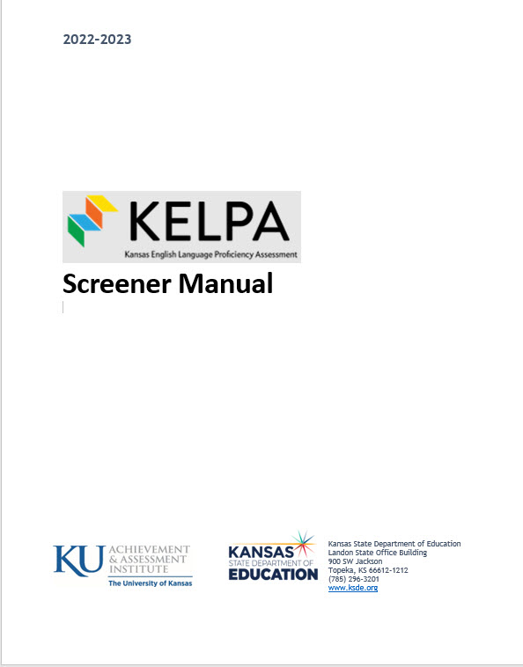
KELPA Screener Manual
The KELPA Screener Manual is NOT considered a secure document.
Download from the KAP website: www.ksassessments.org
Educators and Administrators │ KELPA | Test Administration | Manuals & Guides │ KELPA Screener Manual
or
Resources | Filter by Assessment | Select KELPA Screener

Slide 10
Domains Assessed by Session
Session | Listening | Reading | Speaking | Writing*
Practice¹ | N/A | N/A | N/A | N/A
1 | Yes | Yes | No | No
2 | Yes | Yes | No | Yes²
3 | No | No | Yes³ | Yes³
¹Not scored
²Computer scored
³Educator scored
*Student written response in GK and G1 – use test booklet found on the HELP tab in Educator Portal
Notes:
The practice session contains item types from each domain but is NOT scored. Therefore, it is listed here as N/A.

Slide 11
Registering Students
Two methods to register students:
User Interface
CSV Upload
Notes:
Instructions for registrations are on the following slides.

Slide 12
Registering Students – User Interface
Educator Portal > Settings > Students > Screener Student > Add Student
Required: First Name, Last Name, Local Student ID, District, School, Grade, Educator ID

Slide 13
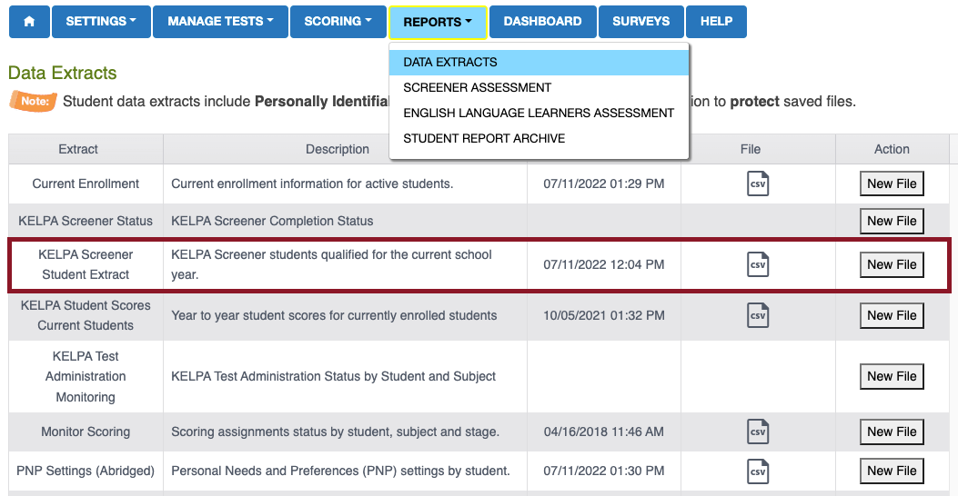
Registering Students – CSV Upload
Step 1: Download KELPA Screener Student Extract.

Slide 14
Registering Students – CSV Upload
Step 2: Modify CSV file in spreadsheet software.
Required fields:
Attendance District
Local Student ID
Student First & Last Names
Attendance School
Grade (used for test assignment)
Educator ID (used for scoring)

Slide 15
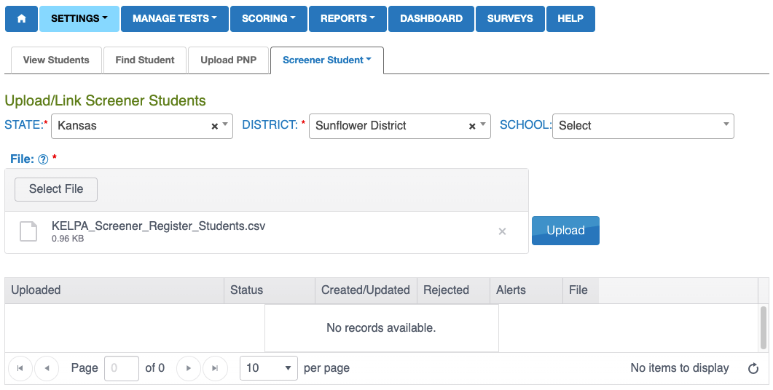
Registering Students – CSV Upload
Step 3: Upload modified CSV file.

Slide 16
Who Can Administer and Score
All educators administering and scoring the KELPA Screener must complete the same training required for KELPA summative.
Training information is available in the KELPA Examiner's Manual.
Each district can determine how to score the speaking and writing constructed-response items.
However, all items must be scored by a licensed educator who is employed by the school district.
Paras may proctor the assessment but may not administer or score it.

Slide 17
Practice Session
The KELPA Screener includes a brief practice session that must be completed before administering the scored sessions.
The practice session is not scored.
Practice tests familiarize students with the format and procedures for responding to different types of items and give students the opportunity to experience available tools and settings.
Instructions for administering the KELPA Screener practice session are found in the KELPA Screener Manual.

Slide 18
Part 2: Technology

Slide 19
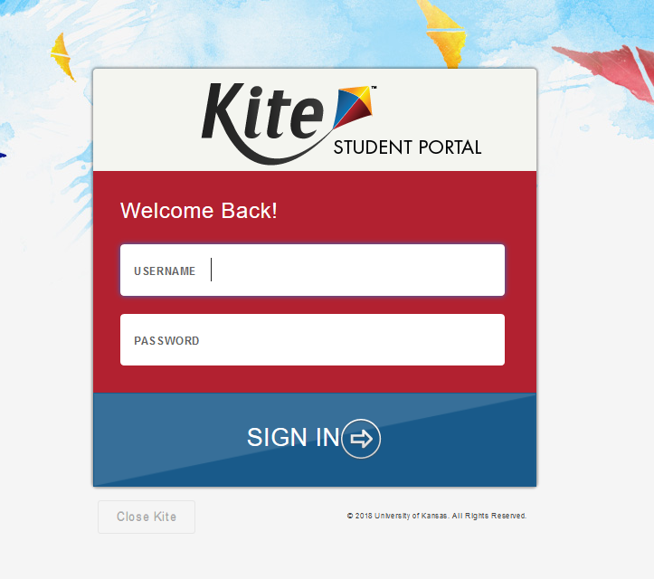
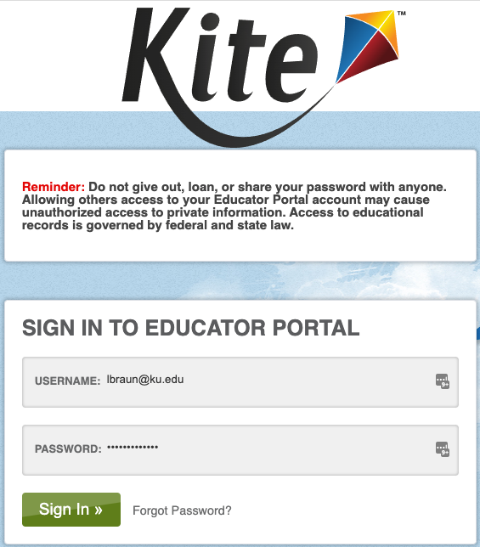
Kite Suite
Student Portal
Educator Portal

Slide 20
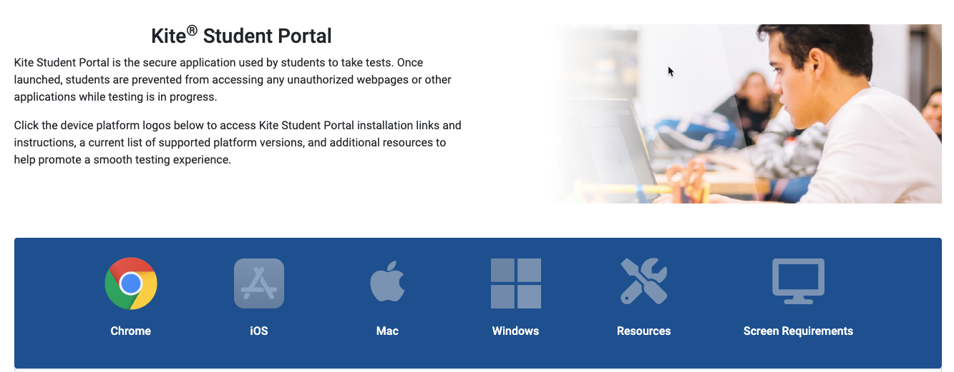
Student Portal Install
Students complete the KELPA Screener using Student Portal.
Find download links and installation instructions on the Technology Coordinators Page of the KAP website.

Slide 21
Whitelisting Kite URLs
Whitelisting allows computers to access websites that your IT team determines safe.
If your school has used the Kite platform, whitelisting is most likely complete.
If not,
ask your IT team to verify the proper Kite URLs are whitelisted prior to testing.
refer to the complete list of URLs; see the Kite Suite Whitelist Settings located on the KAP │ Kite Technology webpage.

Slide 22
Student Portal Manual for Test Administrators
Download from the KAP website: www.ksassessments.org .
Educators and Administrators │ KELPA | Test Administration | Manuals & Guides │ Kite Student Portal Manual for Test Administrators
Resources | Select Category | Select Manuals & Guides

Slide 23
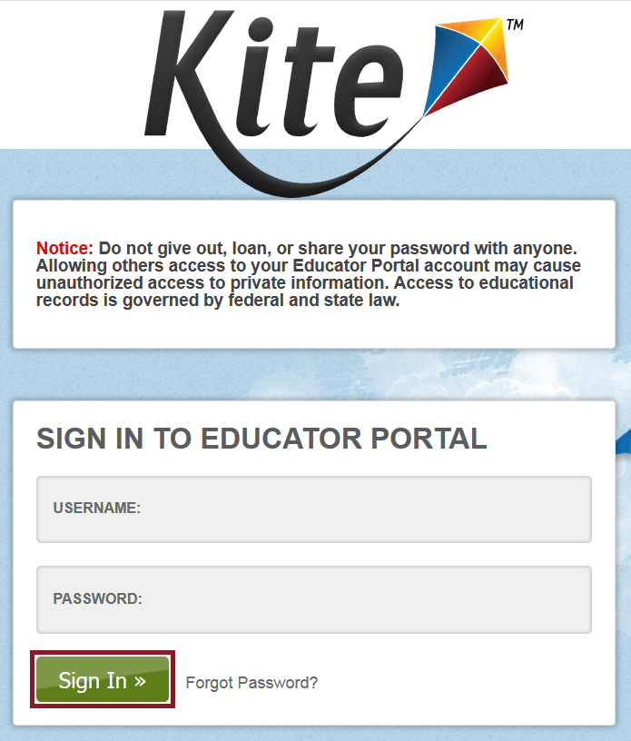
Educator Portal
Any educator who administers and scores the KELPA Screener must have an Educator Portal (EP) account.
The account must be tied to KELPA (not KAP alone).
The account must be established before registering students.
Notes:
Note: If a teacher is not in EP and is included when a student is registered, an error message will appear (user interface method) or the record will not process (CSV upload method)
A building or district test coordinator will need to verify and activate the account. Refer to the Kite Educator Portal Manual for Test Coordinators for more information about creating accounts and assigning roles.

Slide 24
KELPA Screener Test Administration Directions for Session 3
The KELPA Screener Test Administration Directions for Session 3 contains
a list of materials needed for the session.
test administrator scripts to begin the session.
test administrator scripts for kindergarten and grade 1 writing constructed-response items.
Note: This document is for Session 3 only.
Because the document contains item information, the KELPA Screener Test Administration Directions for Session 3 is a secure document. It must be returned to the District or Building Test Coordinator, accounted for, and securely destroyed after use.

Slide 25
KELPA Scoring Rubrics
Rubrics for KELPA and KELPA Screener
is for both KELPA and KELPA Screener.
contains information on using holistic rubrics.
contains rubrics for each grade/grade in both domains (speaking and writing).
Because the document contains scoring information, Rubrics for KELPA and KELPA Screener is a secure document. It must be returned to the District or Building Test Coordinator, accounted for, and securely stored or destroyed after use.

Slide 26
KELPA Screener Rater Training Materials
There is one document for each grade/grade band, containing material for speaking and writing.
Materials provide Anchor Sets containing three student responses at each score point of the rubric.
All constructed-response writing items have Anchor Sets.
There is currently an Anchor Set for one speaking item in each grade/grade band.
The KELPA Screener Rater Training Materials contain item content and are considered secure documents. They must be returned to the District or Building Test Coordinator, accounted for, and securely stored or destroyed after use.

Slide 27
Student Writing Booklets
For kindergarten and grade 1 only
Found on the HELP tab in Educator Portal
Note: Districts are responsible for printing booklets and destroying them after scoring is complete.
Because the documents contain item content, the student writing booklets are secure documents. They must be returned to the District or Building Test Coordinator, accounted for, and securely stored or destroyed after use.

Slide 28
Part 3: Administration

Slide 29
Usernames and Passwords
Students must have a username and password to access the KELPA Screener.
Usernames and passwords are specific to the KELPA Screener.
They are available within Educator Portal:
MANAGE TESTS │TEST COORDINATION
Search for Test Session.
See the KELPA Screener Manual for detailed steps.

Slide 30
Room or Lab Preparation
For more information about preparing the assessment environment, refer to the KELPA Screener Manual.
Note: Dictionaries, translation dictionaries, translators, word lists, etc., are not allowed on the KELPA Screener assessment.

Slide 31
Materials Needed for Testing
Test administrators will need
secure documents for Session 3.
scoring rubrics (as needed if scoring during administration).
Students will need the following:
pencil to take notes
blank scratch paper
headphones for listening to audio
microphone for recording speaking responses in the practice session and Session 3; the microphones can be integrated into the headphones.

Slide 32
Administering the Practice Test Session
Login to Kite Student Portal using Student Usernames and Passwords.
Allows students to practice using technology including listening/speaking
Each item has a video showing how to answer correctly.
Scripts found in KELPA Screener Manual
Not scored, but will give student feedback if answered incorrectly

Slide 33
Administering Sessions 1 and 2
Session 1:
Contains listening and reading items
Scripts found in KELPA Screener Manual
If a student does not answer enough questions correctly to move to Session 2, the administration is complete.
If a student does answer enough questions correctly, they will move to Session 2.
Session 2:
Administered like Session 1
Contains listening, reading, and computer-scored writing items
Scripts found in KELPA Screener Manual.
If the student is Not Proficient after Session 2, the administration is complete.
Otherwise, the student will move to Session 3.

Slide 34
Administering Session 3
Requires secure documents printed or retrieved for administration
Scripts are found in the KELPA Screener Test Administration Directions for Session 3 file on the HELP menu in Educator Portal. All copies must be securely stored (preferably shredded) at the end of testing.
Students in kindergarten and grade 1 will use a writing booklet for writing items. All copies must be securely stored (preferably shredded) at the end of testing. Writing samples are not uploaded to Educator Portal.

Slide 35
Administering Session 3: Technology & Recording for the Speaking Domain
To ensure the recording is loud and clear for scoring, students must use a headset with a microphone to record responses.
To download Kite software, visit ksassessments.org/kite.

Slide 36
Student Portal Navigation Bar
Answered items appear on a white background with a blue border and a blue dot below the number.
Unanswered flagged items
appear on a white background with a red flag.
Answered flagged items appear on a white background with a blue border, blue dot, and a blue flag.
Unanswered items appear on a dark background with a white number.

Slide 37
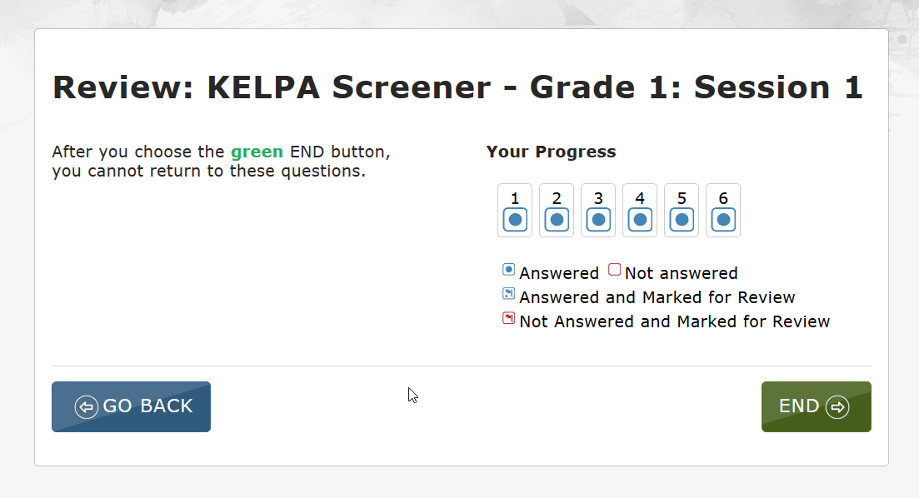
Student Portal Review/End Screen
Teachers must verify that all items have been answered (blue dots) via the Review/End screen in Student Portal before a student ends and exits a session.

Slide 38
Student Portal End Messages
Click END, and a message appears telling the student to continue to the next session, or that the student has completed KELPA Screener.
or

Slide 39
Troubleshoot with the KELPA Screener Manual when…
the test administrator is unable to view the End messages to determine if a student’s test session is complete.
First, check a student’s Student Portal test-selection screen to see if the next session appears.
Second, look in Educator Portal under the REPORTS menu or under the MANAGE TESTS menu in TEST COORDINATION menu.
a student has omitted items or did not finish a test session because of illness, time constraints, or other factors.
a session needs to be reactivated.
the test administrator needs to monitor student testing status in Educator Portal.

Slide 40
Part 4: Scoring

Slide 41
Who Can Score
Session 3 items must be hand scored locally by educators.
Educators associated with the student’s registration are assigned as scorers.
Users with the roles of District Test Coordinator, District User, Building Test Coordinator, or Building User may also score Session 3.
Notes:
There are 5 speaking items requiring hand scoring in all grades/grade bands. There is one writing item in each grade/grade band requiring scoring, except grade 2-3, which has two items requiring hand scoring.

Slide 42
Number of Items Requiring Hand Scoring
Grade or Grade Band | Speaking | Writing
Kindergarten | 5 | 1
1 | 5 | 1
2–3 | 5 | 2
4–5 | 5 | 1
6–8 | 5 | 1
9–12 | 5 | 1

Slide 43
Rubrics
Specific guidance and rubrics for item scoring at each grade level or band are in the HELP tab in Educator Portal.
THESE DOCUMENTS ARE SECURE! At all times, it is important to maintain the security of the rubrics and scoring documents.
Note: KELPA Screener rubrics are the same as KELPA summative rubrics.

Slide 44
Scoring in Educator Portal
Notes:
Log into Educator Portal.
Select the Scoring menu, then KELPA SCREENER.
Select the Score Tests tab and complete the appropriate fields.
Select a test to score, scroll to the right to see the items to score.
Select an item to score.

Slide 45
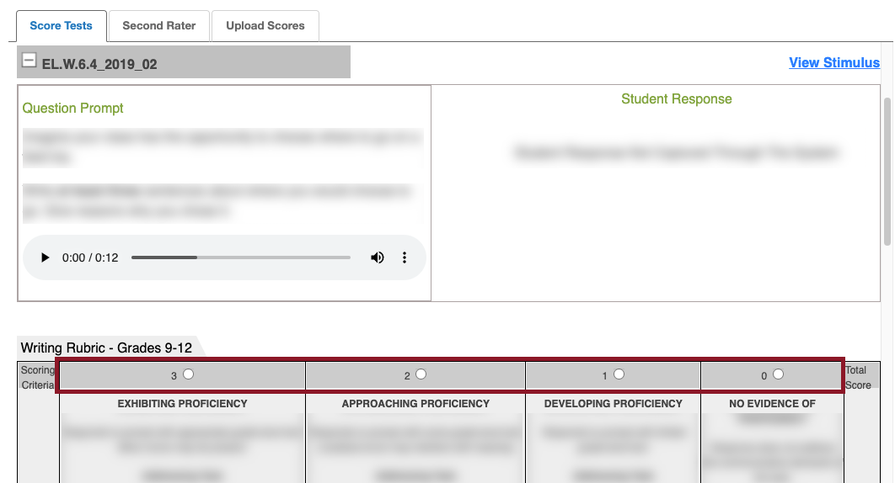
Scoring in Educator Portal
Notes:
This image shows a screenshot of the Score Tests tab in Educator Portal. To score, review the question prompt and student response, then select the appropriate score using the radio buttons above the rubric in the “scoring criteria” row.

Slide 46
After Scoring – Generate Report
After all items scored
Generate Report
Notes:
Reports are automatically generated if a student does not answer enough items correctly after Session 1 or Session 2 and are immediately available in the Reports section.

Slide 47
Part 5: Reports

Slide 48
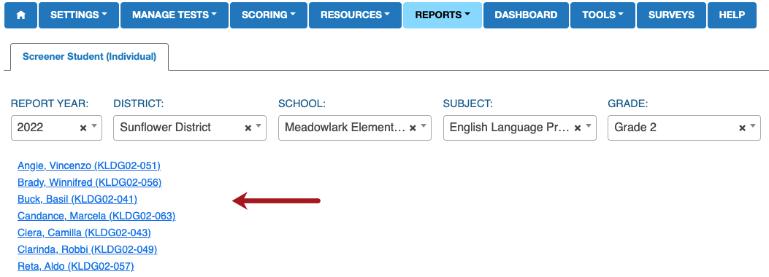
Student Score Reports in Kite® Educator Portal
Access KELPA Screener reports under REPORTS in Educator Portal.
REPORTS │ SCREENER ASSESSMENT
Complete the required drop-down menus.
Select the student’s name to download the PDF report.

Slide 49
Part 6: Conclusion

Slide 50
Kite® Service Desk
For technology questions, please contact the Kite Service Desk.
To report issues with an item, please contact the Kite Service Desk. Follow procedures outlined in Test Security and Ethics training.
Kite Service Desk: kap-support@ku.edu |855-277-9752 | Live Chat
Notes:
Item issues may include graphics not loading correctly, inability to select a response, audio or recording problems, etc.

Slide 51
Personally Identifiable Information
Do NOT send students’ Personally Identifiable Information (PII) via email. This is a federal violation of the Family Educational Rights and Privacy Act (FERPA). PII includes such information as a student’s name, building name, or district name.
DO send the student ID number, session number, the item number, and the error or concern you are reporting regarding the test taker.

Slide 52
Materials and Resources
Location: KAP Website
KELPA Screener Manual
Online training
Kite Student Portal Manual for Test Administrators
Practice Test Guide for Educators
KELPA Scoring Manual
Location: Educator Portal HELP tab
Rubrics for KELPA and KELPA Screener
KELPA Screener Test Administration Directions for Session 3
KELPA Screener Kindergarten Writing Booklet
KELPA Screener Grade 1 Writing Booklet
KELPA Screener Rater Training Materials (grade/grade band specific)

Slide 53
Important Dates
Date | Event
August 1, 2022 – July 21, 2023 | Screener available in Kite Student Portal
Student enrolling on first day of school | Screener must be administered to student within 30 days of enrollment
Student enrolling after 1st day of school | Screener must be administered within 2 weeks of enrollment
July 24 – 28, 2023 | Kite Suite unavailable due to annual maintenance

Slide 54
Julie Ewing, KSDE
jewing@ksde.org
Questions?

