Slide 1
KELPA Test Coordinator Training
Kansas Assessment Program
2024

Slide 2
Agenda
KELPA Overview
Security & Ethics
Accommodations
Before KELPA testing begins
During KELPA testing
After KELPA testing

Slide 3
KELPA Overview

Slide 4
2024 KELPA Overview
Test Design
Aligns with the Kansas EL standards, Board approved (September 2018)
Fixed form, 4 test sessions (domain specific)
Tested Domains: Reading, Writing, Listening, Speaking
When administering the assessment, you may give the domains in any order.
Grade Band Tests: K, 1, 2-3, 4-5, 6-8, 9-12

Slide 5
KELPA Administration/Scoring
Each district has the flexibility to determine when you will administer the KELPA assessment statewide window.
A licensed educator who is employed by the school district should administer the assessment.
A para, under the direction of a licensed educator, may administer the KELPA assessment if they have gone through the required Test Security and Ethics training.
Each district has the flexibility to determine how you will score the assessment items in writing and speaking. However, all items must be scored by a licensed educator who is employed by the school district.

Slide 6
KELPA Materials and Resources
Location: KAP Website
KELPA Examiner’s Manual
KELPA Scoring Manual
Kite Student Portal Manual for Test Administrators
Practice Test Guide for Educators
KELPA Test Training PowerPoint
Location: Kite Educator Portal Help Tab
THESE DOCUMENTS ARE SECURE
Test Administration and Scoring Directions for Writing (All grades)
Includes Grade K and 1 Writing Booklets
Test Administration and Scoring Directions for Speaking (All grades)
Rater Training Materials
KELPA Rater Training Materials for Writing (Grade specific)
KELPA Rater Training Materials for Speaking (Grade specific)

Slide 7
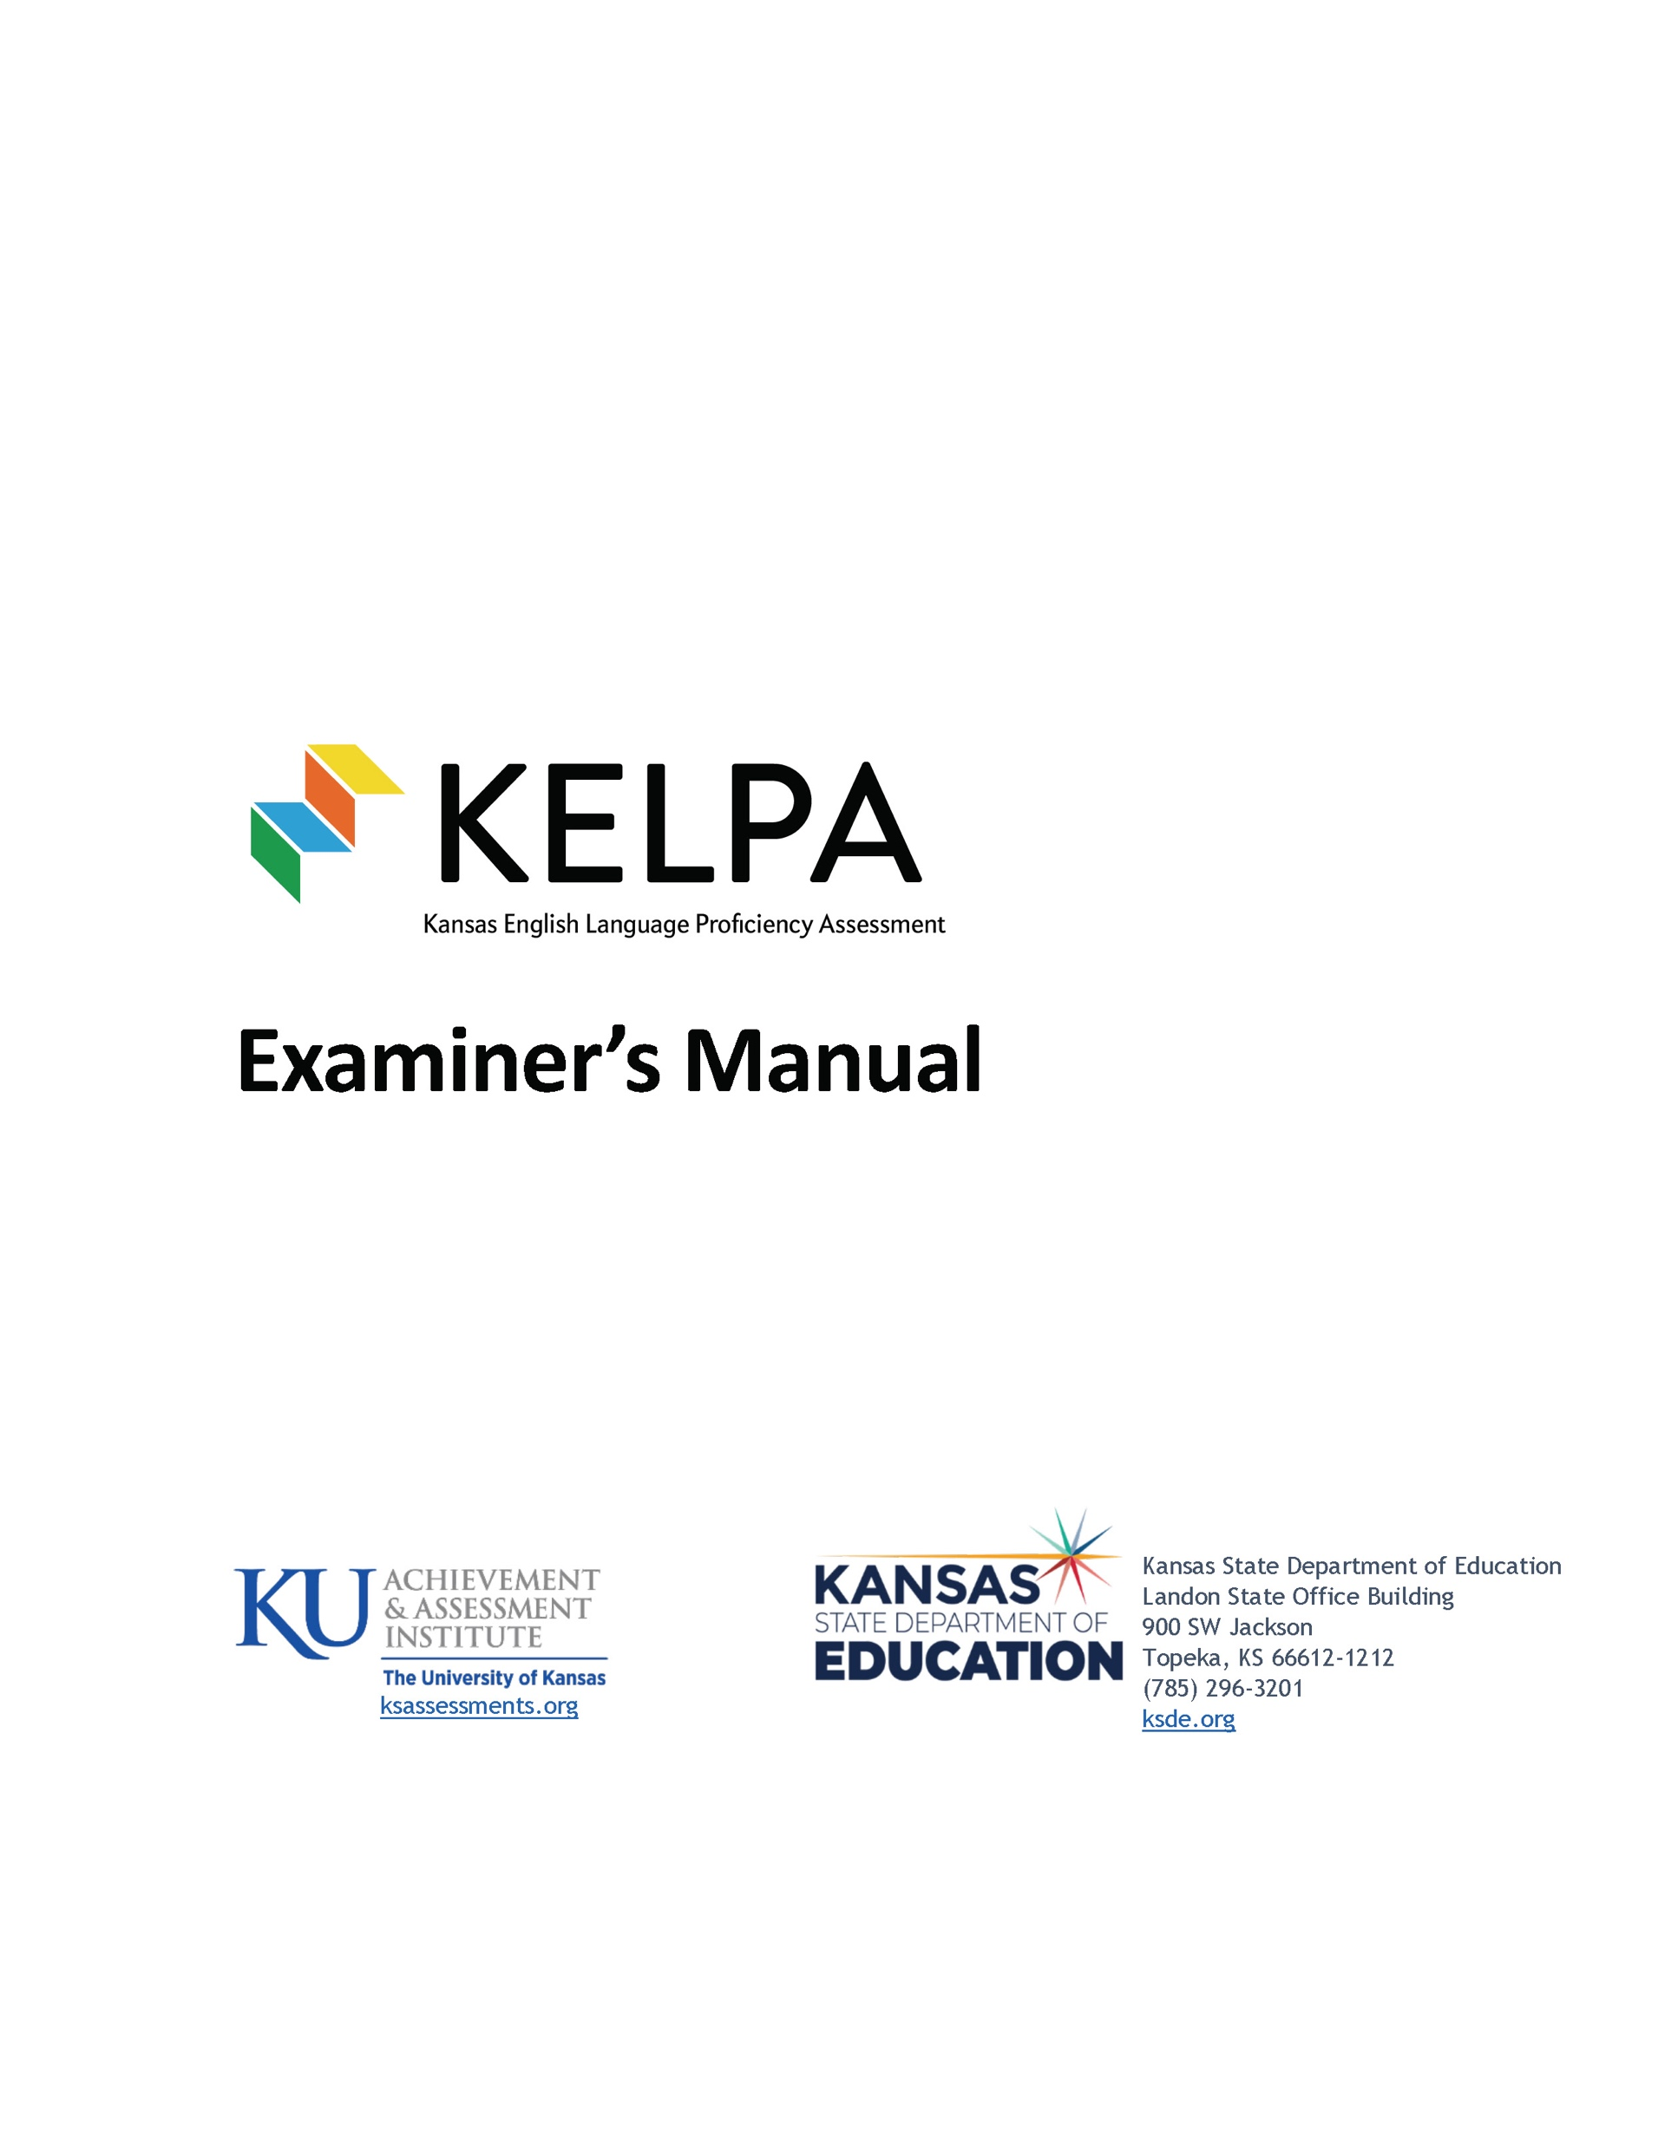
KELPA Examiner’s Manual
Download from the KAP website: www.ksassessments.org
Educators & Test Administrators
Test Administration
Manuals & Guides
KELPA Examiner’s Manual
This document is NOT considered a secure document.

Slide 8
Monitored and Transitional ESOL students
Students on monitored and transitional status do not take the KELPA.
If you have trouble uploading test records to KIDS for monitored and transitional status students, it is because KSDE does not allow those students to be signed up for the KELPA assessment.

Slide 9
KELPA Domain-Assessments and Item Count
 | Number of Items Computer Scored |  |  | Number of Items Educator Scored
Grade Band | Listening | Reading | Writing | Writing | Speaking
K | 23 | 19 | 6* | 4 | 10
1 | 25 | 25 | 9* | 4 | 10
2—3 | 25 | 24 | 15 | 4 | 10
4—5 | 25 | 22 | 13 | 4 | 10
6—8 | 25 | 21 | 15 | 3 | 10
9—12 | 24 | 23 | 14 | 3 | 10
* Student written response – use test booklet found in the Test Admin. and Scoring Directions

Slide 10
KELPA Testing and Scoring Windows
Testing Window
January 29, 2024 – March 8, 2024
Scoring Window
January 29, 2024 – March 29, 2024

Slide 11
2024 KELPA: Testing Time
Students my take as much time as they need, but the test is designed to take approximately 45-60 minutes
Estimated time based on number of test items indicates less time is needed, but to be safe, allocate 45-60 minutes

Slide 12
Grade K and Grade 1 Writing
For some questions, students respond directly on the computer. These questions are machine scored. Other answers are written in a student test booklet and are human scored.
The test booklets will need to be retrieved from the Help tab in Educator Portal prior to testing
The Test Administration and Scoring Directions documents provide further guidance and include the student test booklets.

Slide 13
Security & Ethics

Slide 14
Test Proctor Responsibilities
Must complete Security & Ethics training and sign agreement
Follow all test procedures
Ensure students are taking their own test
Monitor test environment
Report any breach of test security to your building test coordinator

Slide 15
Prohibited Practices
In general, unless directly specified by the KELPA Test Administration and Scoring Directions, reading any text to students (including isolated words) in a KELPA domain-assessment is prohibited. Violations will result in the student being counted as not tested.
Passages, items, response choices, or labels may not be translated into a student’s first language or any language.
Teachers and students may not bring pre-generated organizers, journals, logs, or notes into a test session. Students may create notes during a test session but are not required and should not be prompted to do so.

Slide 16
Accommodations

Slide 17
Accommodations
PNP must be compete before test window opens
Accommodations must be documented on the student’s Individualized Education Program (IEP), 504, or Individualized Learning Plan (ILP)
Spanish translations are not included in KELPA

Slide 18
Before KELPA

Slide 19
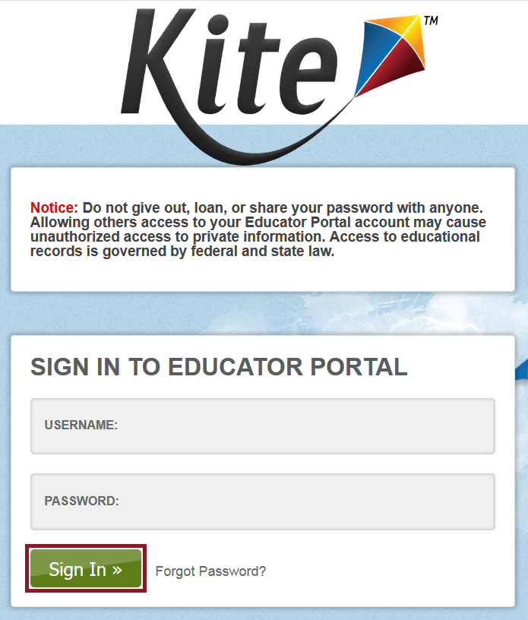
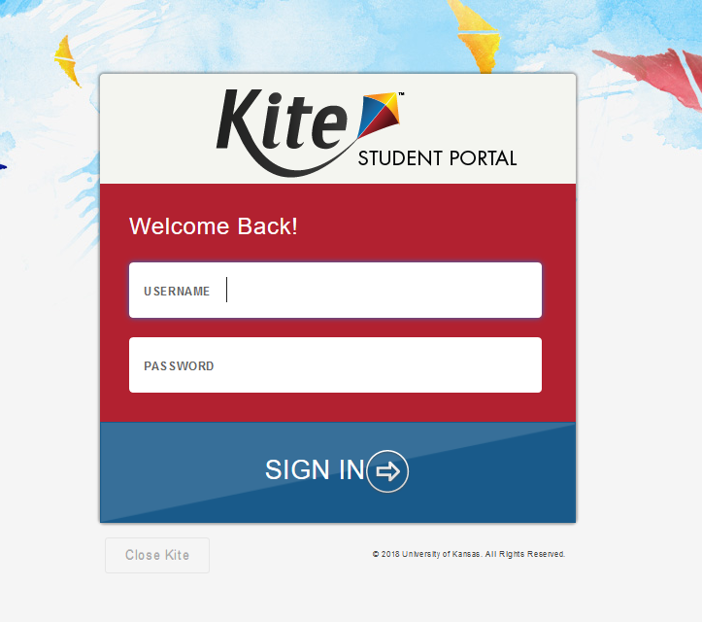
Kite Suite
Student Portal
Educator Portal

Slide 20
Install Kite Student Portal
Students complete the KELPA assessment using Kite Student Portal.
Download links and installation instructions can be found on the KAP Technology Coordinators Page ksassessments.org/technology-coordinators

Slide 21
Whitelisting Kite URLs
Whitelisting is the practice of allowing specific URLs that are certified as safe to access your network. Student Portal will need to communicate with Kite servers during a student's test session.
Verify you have whitelisted the proper Kite URLs prior to testing.
Refer to the Kite Suite Whitelist Settings document located on the KAP Technology Coordinators page for the complete list of URLs.

Slide 22
Kite Student Portal Manual for Test Administrators
Download from the KAP website: www.ksassessments.org
Educators & Test Administrators
Test Administration
Manuals and Guides
Kite Student Portal Manual for Test Administrators

Slide 23
Kite Educator Portal
Any educator who is responsible for KELPA administration and scoring must have an Educator Portal account.
This account must be tied to KELPA.
This account must be established prior to sending in your TEST records.

Slide 24
Submit TEST records
Submit TEST records to KIDS.
Include Scorer ID and name in the proctor fields.
KIDS Help Desk: KIDS@ksde.org 785-296-7935

Slide 25
Kite Service Desk
If you have any questions or need assistance regarding technology, please contact the Kite Service Desk.
To report item issues, please contact the Kite Service Desk. Follow procedures outlined in Test Security and Ethics training.
Kite Service Desk: kap-support@ku.edu |855-277-9752 | Live Chat

Slide 26
Personally Identifiable Information
Do not send any Personally Identifiable Information (PII) for a student via email. This is a federal violation of the Family Education Rights and Privacy Act (FERPA). PII includes such information as a student’s name, building name, or district name.
Do send the student ID number, the KELPA domain test the students are taking (reading, writing, listening, speaking), the item number and the error or concern you are reporting regarding the test taker.

Slide 27
Headset: Recording Oral Responses for the Speaking Domain Test
Students must use a headset with a microphone to record responses to ensure the recording is loud and clear for grading.
Students can use any device, including iPads, to complete KELPA speaking tests.

Slide 28
KELPA & Technology Practice Tests
It is important that students can practice the Kite software and develop a comfort level for using the technology.
Practice tests are available in three grade bands:
Grades K and 1
Grade bands 2-3 and 4-5
Grade bands 6-8 and 9-12
Also available are technology-specific practice tests which allow students the opportunity to become familiar with the Kite software.

Slide 29
Kite Practice Test Guide for Educators
Download from the KAP website: www.ksassessments.org
Educators & Test Administrators
Test Administration
Manuals & Guides
Practice Test Guide for Educators

Slide 30
View Rater Training Materials
Log into Kite Educator Portal
KELPA
Help Tab
Because the documents contain scoring information, the Rater Training Materials are SECURE documents. These must be returned to the District/Building test Coordinator, accounted for, and securely destroyed after use.

Slide 31
During KELPA

Slide 32
Usernames and Passwords
Students must have a username and password to access the KELPA test.
Usernames and passwords are the same for all tests, including KELPA, and are available within Educator Portal:
REPORTS > DATA EXTRACTS > STUDENT INFORMATION > Student Login Usernames/Password

Slide 33
Daily Access Codes
In addition to a username and password, a student also needs a Daily Access Code (DACs) to access the KELPA assessment.
Daily Access Codes allow students to launch each domain-assessment. Each day during the testing window, there is a unique code for each domain-assessment; however, within a grade level, all students use the same codes.

Slide 34
Daily Access Codes
Daily Access Codes are found in Kite Educator Portal at MANAGE TESTS > TEST COORDINATION > View Daily Access Codes.
Kite users with the role of DTC, DU, and BTU have access to the Daily Access Codes.
Daily Access Codes can be retrieved from Educator Portal beginning at 2:30 p.m. the day before testing day and the entire day of testing.
See the Kite Educator Portal Manual for Test Coordinators for more information about downloading Daily Access Codes.

Slide 35
Room/Lab Preparation
Refer to the KELPA Examiner’s Manual
Reminder – the use of dictionaries, translation dictionaries, translators, word lists, etc. are NOT allowed on the KELPA test

Slide 36
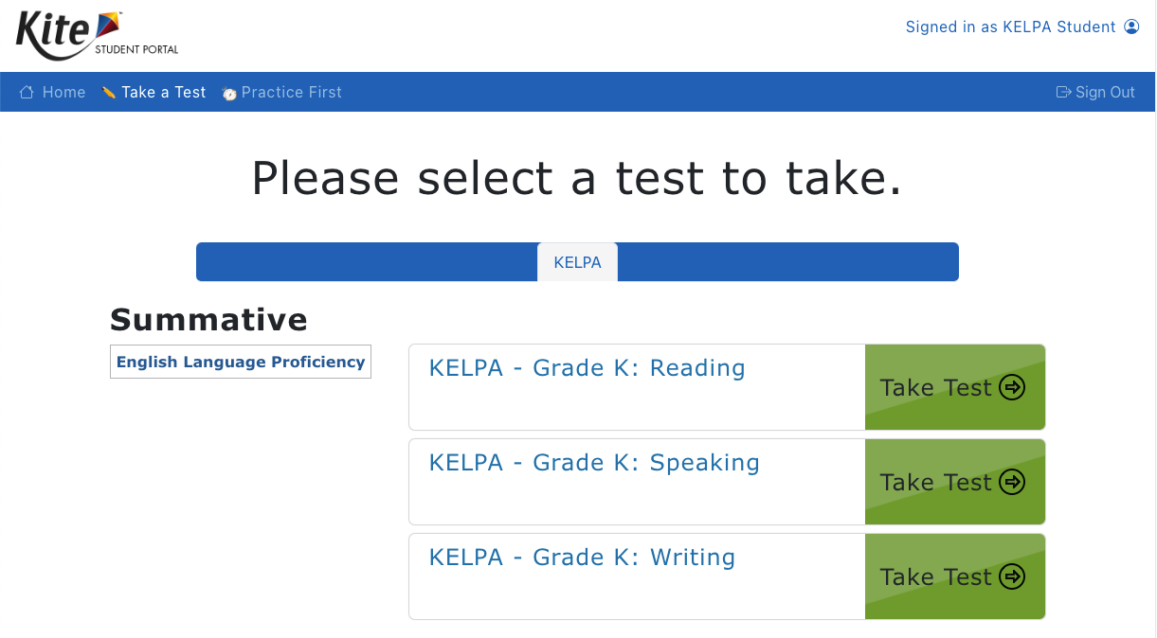
Kite Student Portal
To begin a test session, tell students to perform the following steps:
Select the Kite icon. Enter username and password.
Select Sign In.
Select Take Test.
On the blue bar, select KELPA (if needed).
Find the appropriate test and select Take Test.
Enter the Daily Access Code when prompted.

Slide 37
Kite Student Portal
Before students can enter the test, they must test their microphone.
Select the blue microphone icon. The icon should turn red once it is ready.
Record a few words.
Select the microphone icon again to stop recording.
Select the play button to hear your recording. Select the speaker icon to adjust the volume.
Once the recording is tested, select Let’s Go. If you need to exit out of the test to adjust the microphone or speakers on the testing device, select Go Home and exit Kite Student Portal.

Slide 38
Student Portal Navigation Bar
Answered questions appear on a white background with a blue border and a blue dot below the number.
Flagged questions that are unanswered appear on a white background with a red border and a red flag below the number.

Slide 39
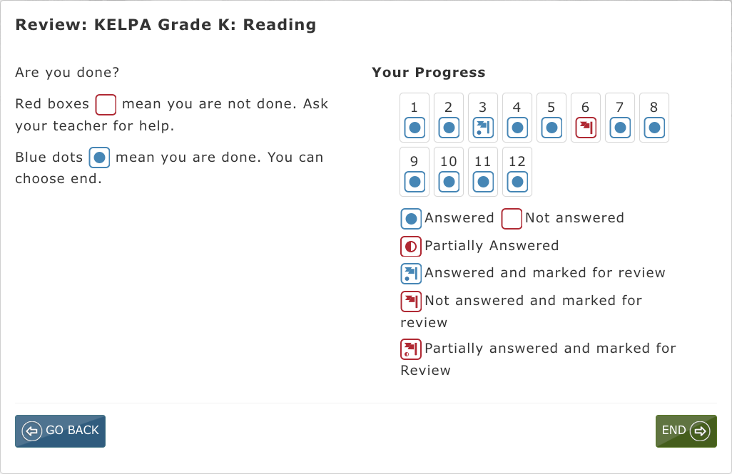
Student Portal End Review Screen

Slide 40
After KELPA

Slide 41
Hand Scoring Speaking & Writing
Educators must complete rater training prior to scoring KELPA items and must have accounts in Kite Educator Portal. The educator should be assigned the role of Teacher in Educator Portal. For assistance, contact the District or Building Test Coordinator.
Educators associated with the student’s TEST record will be assigned as the Scorer.
The window for hand scoring speaking and writing items runs from January 29 – March 29, 2024, closing on March 29.
Scoring may begin immediately after the window opens. KSDE does not recommend waiting to begin scoring until after the KELPA window closes.

Slide 42
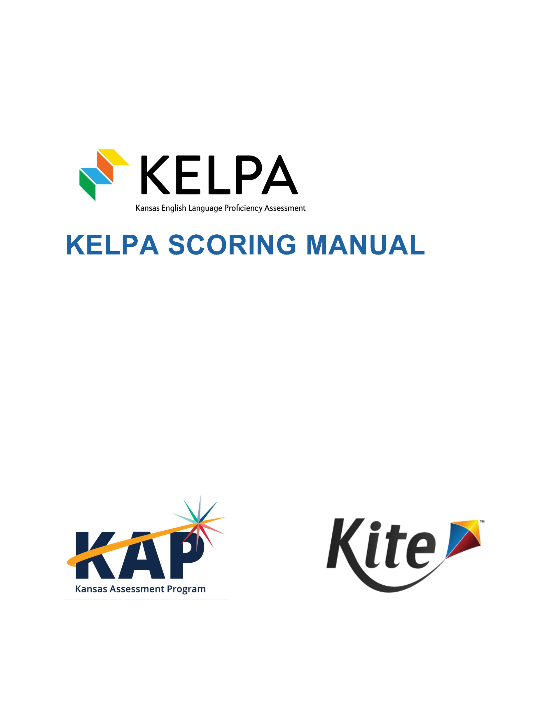
KELPA Scoring Manual
Step-by-step instructions on how to enter score information into Kite
Download from the KAP website: www.ksassessments.org
Educators & Test Administrators
Test Administration
Manuals & Guides
KELPA Scoring Manual

Slide 43
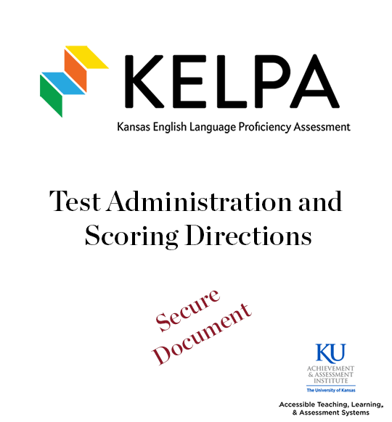
Test Administration and Scoring Directions
Test Administration and Scoring Directions are:
Specific to the domain – writing or speaking
Secure documents
Because the documents contain scoring information, the Test Administration and Scoring Directions are secure documents. These must be returned to the District/Building test Coordinator, accounted for, and securely destroyed after use.

Slide 44
Test Administration and Scoring Directions
For Speaking, there is one document for all grades.
For Writing, there are documents for kindergarten, grade 1, and grades 2-12.
Each document includes:
Scripts for test administration
Scoring information, scoring rubrics, scoring codes, and writing booklets
These are secure documents. Documents must be kept secure throughout testing and shredded after completion of testing/scoring.

Slide 45
Test Administration and Scoring Considerations
We recommend that you administer the writing and speaking assessments early in the testing window to allow time for the completion of human scoring.
Determine if your district will be using deferred or simultaneous scoring for speaking items. This will impact the number of personnel needed to administer the speaking domain-assessment.

Slide 46
Second Rater
To meet federal reporting requirements, the KELPA program is required to obtain second rater scores for some students.
Schools with 10 or more EL students at a grade/grade band will be randomly selected for double scoring.
A sample of students within selected schools will be selected for a rater-agreement study. Students selected for the study will be double scored independently, depending on the scoring methods used in each individual school district.
The scoring method for writing and speaking items should be determined prior to administering the KELPA and entered into Kite Educator Portal.

Slide 47
Second Rater Guidelines
Student responses selected for double scores need to have two scores that are independent of each other. That is, the two scores for a given item response need to be assigned by two independent scorers.
Scorers who participate in a pair/group scoring calibration activity and shared their thoughts on their scores assigned to a student response should NOT be considered as two independent scores.
Assign scorers using the same scoring method for the two scores. For speaking items, deferred scoring is recommended for both scores.

Slide 48
Second Rater: Monitor Scoring
District and Building level users can monitor Second rater scoring using the Monitor Scoring Extract
Reports > Data Extracts > Test Administration and Monitoring > Monitoring Scoring
Column called "Rater"

Slide 49
Second Rater: Monitor Scoring Extract Screenshot
Rater is now listed in column N on Monitoring Scoring extract.
Column S will show "Scoring Status" for Primary and Secondary scores.

Slide 50
Test Administration and Scoring Directions Student Writing Booklets for Grade K and 1
Test Administration and Scoring Directions contain:
Student writing booklets
Test Administrator scripts
Districts are responsible for printing these booklets and destroying them after uploading to Kite Collector.
Because the documents contain scoring information, the Test Administration and Scoring Directions are SECURE documents. These must be returned to the District/Building test Coordinator, accounted for, and securely destroyed after use.

Slide 51
Submitting Grade K and Grade 1 Writing Responses
All Grade K and Grade 1 student writing responses, sometimes referred to as samples, will be uploaded into Educator Portal.
The window for uploading responses is January 29—March 29, 2024. Writing booklets must be uploaded by 11:59 p.m. on March 29.
Users with the roles of DTC, DU, BTC, and BU may upload KELPA student writing responses into Educator Portal.

Slide 52
Submitting Grade K and Grade 1 Writing Responses
1. Make a PDF(s) by grade of the writing responses that will be uploaded. A single pdf file should be limited to no more than 250 writing responses.
2. Writing responses may be uploaded by district or by building.

Slide 53
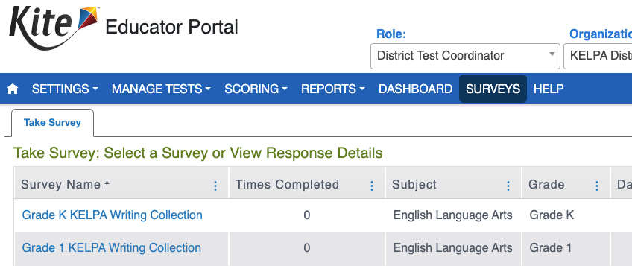
Submitting Grade K and Grade 1 Writing Responses
3. Enter Educator Portal and select SURVEYS. The Take Survey will display.
4. Select the Grade K or Grade 1 Writing Collection link under the Survey Name heading.

Slide 54
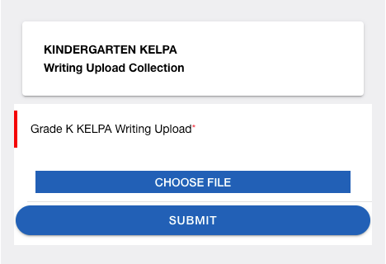
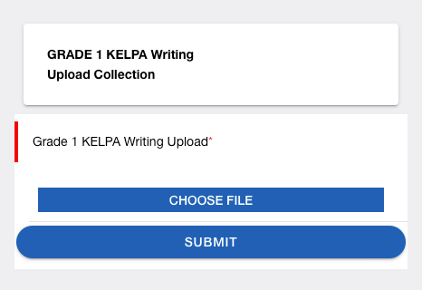
Submitting Grade K and Grade 1 Writing Responses
5. The system will launch the upload process, prompting the user to upload a file and fill out the remaining fields.
6. Choose a single PDF. If there are multiple PDFs, complete the survey once for each PDF.
7. Submit.
Once submitted, a message will appear indicating successful submission of responses. You will be taken to the login page for Kite Collector and you will close the app.

Slide 55
Contact Information
Kite Service Desk (855) 277-9752 kap-support@ku.edu
KAP Assessments Julie Ewing (785) 296-2325 jewing@ksde.org
KELPA Twyla Sprouse (785) 296-5674 tsprouse@ksde.org

